Slide 1


Python Basics

Slide 2
Contents
Invention
Why and What is Python ?
Applications of Python
Introduction to Anaconda and Jupyter
Working with the Jupyter Notebook and Markdown Formats
Working with Strings and String Functions
Python Functions
Conditional Formatting in Python
Lists,Tuples,Sets,Dictionaries
Packages and Modules
Regular Expressions

Slide 3

Moto Behind Invention
Python’s Benevolent Dictator For Life “Python is an experiment in how much freedom programmers need. Too much freedom and nobody can read another's code; too little and expressiveness is endangered.”
- Guido van Rossum

Slide 4
Why Python ?
Python becomes a basic language
Python language is top in IT industry
Learning python can easily grab knowledge on Advanced courses like Machine learning and Data science.
It is a Open Source

Slide 5
What Python ?
Python is an interpreted, high-level, general-purpose programming language.
It includes data structures, dynamic typing, dynamic binding, and many more features that make it as useful for complex application development.
It is Object Oriented,Portable and Powerful Language.
It is used as both Programming and Scripting Language

Slide 6


Applications with Python

Slide 7

Anaconda
Def: Is a platform/navigator to run python
Why should we use Anaconda for Python?
Anaconda is popular because it brings many of the tools used in data science and machine learning.
Anaconda contains,popular python libraries that can be used in data science .
It also comes with the jupyter notebook and Ipython distribution. So, it saves you from importing numerous libraries separately
Link for installation of Anaconda Software: https://www.anaconda.com/distribution/

Slide 8

Jupyter
Jupyter is a web - application
Jupyter's name is a reference to the three core programming languages supported by Jupyter, which are Julia, Python and R
Jupyter Notebook: The Jupyter Notebook is an open-source web application that allows you to create and share documents that contain live code, equations, visualizations and narrative text.
Uses include: data cleaning and transformation, numerical simulation, statistical modeling, data visualization, machine learning, and much more.
Advantages: Best for data exploration, data preparation, data validation, Productionalization

Slide 9
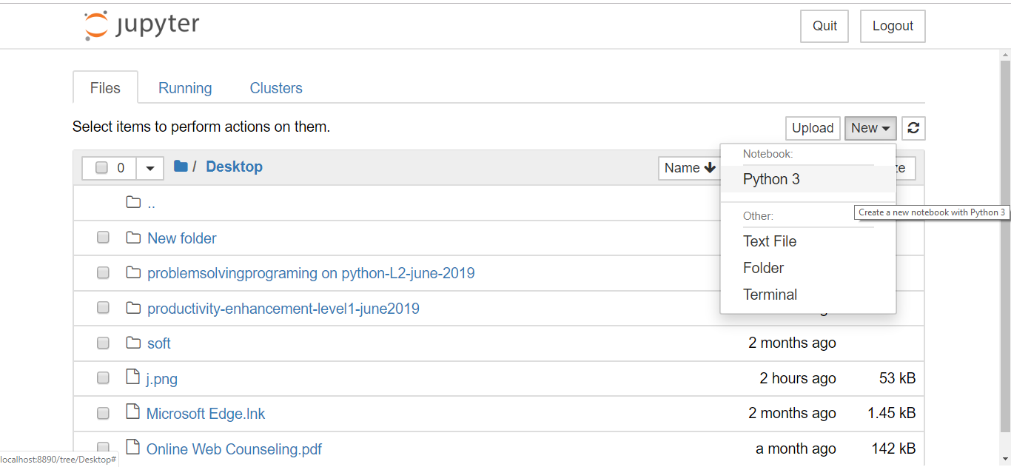
Working with Jupyter Notebook
Open Anaconda Navigator
Open Jupyter Notebook by clicking on “Launch” option below the Jupyter Notebook application
Opening of a new Python Notebook:
After launching the Jupyter Notebook
Create a folder on the Desktop by entering Desktop folder
Click on New (at the right side) >> Folder
Give a name(Problem Solving Programing on Python) to that folder
Enter that folder New >> Python 3
Give a name to that Notebook (today’s date)

Slide 10
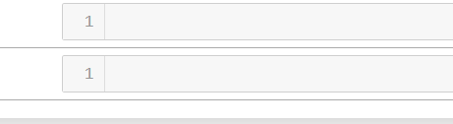
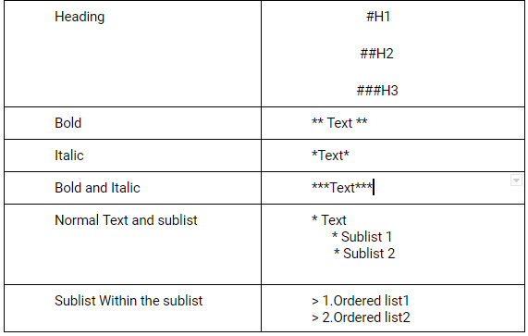
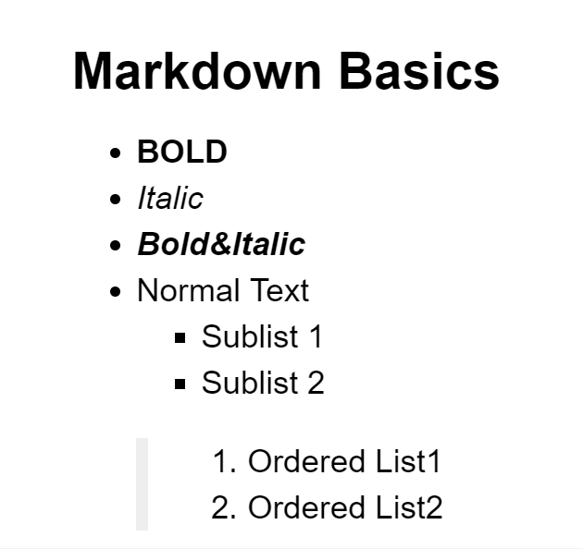
Markdown Format for Documentation
Markdown cell displays text which can be formatted using markdown language. In order to enter a text which should not be treated as code by Notebook server, it must be first converted as markdown cell either from cell menu or by using keyboard shortcut M while in command mode. The In[ ] prompt before cell disappears.
The cell will appear like
Reference for Markdown Commands: https://www.markdownguide.org/cheat-sheet/

Slide 11
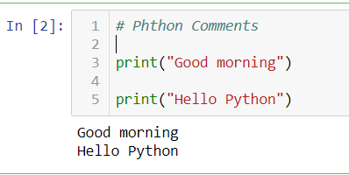
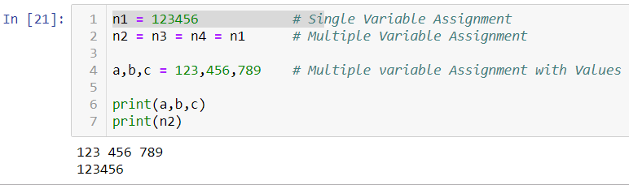
Python Basics
Python Variables:
A variable in programming is used to store the values/data Different types in variable assignments
Print Hello Python Using Python language

Slide 12
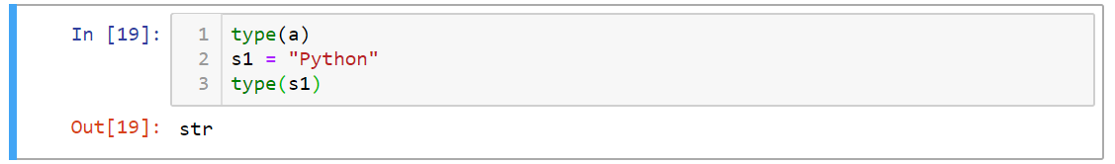
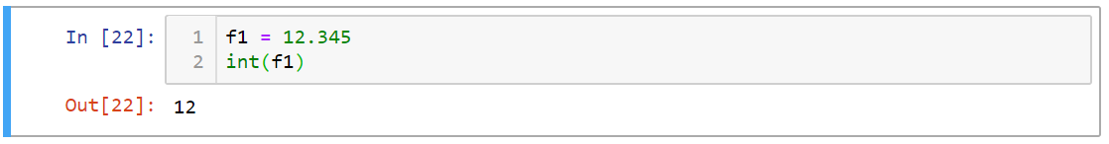
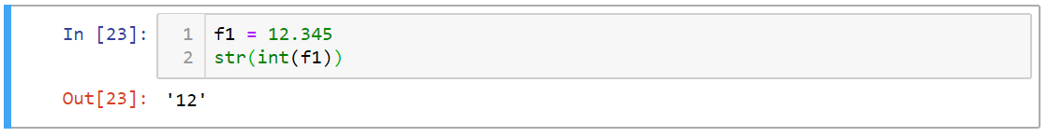
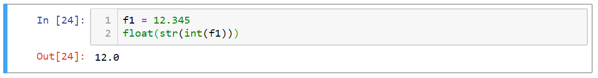
Data Types and Conversion
int - holds signed integers of non-limited length.
float - holds floating precision numbers and it’s accurate upto 15 decimal places.
string - holds a sequence of characters In Python we need not to declare data type. We can simply just assign values in a variable. But if we want to see the type of value is it holding right now, we can use type().
By Using type(s1) , s1 type will be printed
Type of f1 is float, but here by using int(f1), f1 is converted into integer value
By using str(f1), int(f1) is converted into string type
By using float(f1), str(int((f1))) is converted into string type

Slide 13
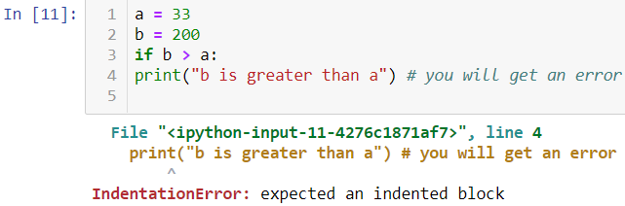
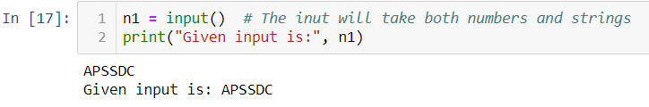
Indentation
Python relies on indentation, using whitespace, to define scope in the code. Other programming languages often use curly-brackets for this purpose. If there is no proper indentation, we will get an error.
Reading the input Dynamically
For this purpose, Python provides the function input(). It always returns a string. Methods to take different types of inputs String as input: intput() This will take both numbers and strings as input

Slide 14

String Slicing
The Python string data type is a sequence of one or more individual characters that could consist of letters, numbers, whitespace characters, or symbols. We access strings through indexing, slicing them through their character sequences, and go over some counting and character location methods.
How Strings are Indexed? Each of a string’s characters correspond to an index number, starting with the index number 0. In this spaces also be indexed. Example: Index of HELLO WORLD!
Accessing Characters by Positive Index Number
Accessing Characters by Negative Index Number

Slide 15
Methods in String Slicing
split() Method - split() method returns a list of strings after breaking the given string by the specified separator.
Syntax: We will write split() method as - string.split()
join() Method - The join() method is a string method and returns a string in which the elements of sequence have been joined by str separator.
Note: Python strings are case sensitive
islower() - To check all characters in a string is lowercase alphabets or not
isupper() - To check all characters in a string is uppercase alphabets or not
lower() - To change all the characters of a string to lowercase
upper() - To change all the characters of a string to uppercase
count() - To find how many times a specific character repeated in a string

Slide 16
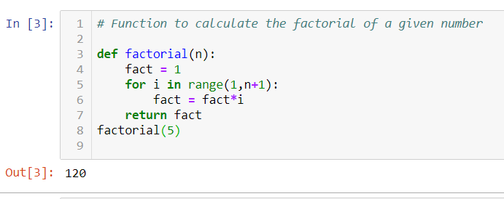
Functions
Python provides built-in functions like int(), input(), float(), print(), abs(), chr(), etc. but we can also create your own functions. These functions are called user-defined functions.
Parameters: A parameter is a variable used to define a particular value during a function definition.
Arguments: An argument is a value passed to a function at the time of function calling.
Examples on Functions: Function to find the factorial
Types of functions in Python
Without arguments & without return values
Without arguments & with return Value
With arguments & without return values
With arguments & return values

Slide 17
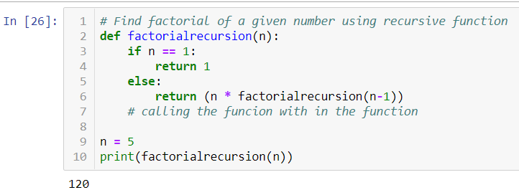
Recursive Functions
When a function call itself is known as recursive functions.
Advantages of recursive function
Recursive functions make the code simple.
A complex task can be broken down into sub tasks by using recursion.
Example on Recursive function
Write a function to find the factorial of a given number with recursion

Slide 18
Conditional Statements
If Statement: If the given condition is True,then the statements inside the body of “ if ” execute. If the given condition is False, it doesn't print the result .
If...else Statement: If the given condition is True, then the statements inside the body of “if” are executed. If the given condition is False, then the statements inside the body of “else” are executed.
If..elif...else: ELIF is nothing but else that allows the user to check the number of users. If the “if” block evaluates as False, then condition checks next “elif” block. If all “elif” conditions evaluate as False, then the “else” statement will executed.
Nested if Statement: When an if else statement is present inside the body of another “if” or “else” then this is called nested if else.

Slide 19
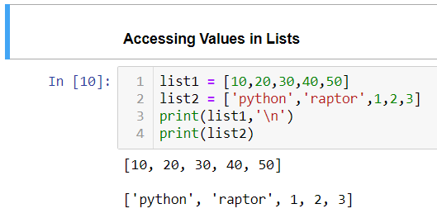
Data Structures
Data Structures: Data Structures are used to store the collection of data together. Python has four types of inbuilt data structures.
Lists
Tuples
Dictionaries
Sets
1. Lists: Lists in Python Data Structures are used to store the collection of multiple data. Lists are ordered and immutable or changeable. Lists allows duplicate elements or values. Lists are represented as square brackets. Ex: list = [ ]

Slide 20
Lists Methods: L1 = [ 1, 2, 3 ] L2 = [ 10, 20, 30 ] L3 = [ 19, 12, 25, 12, 28, 12 ]
append( ) - Adds an item at the end of the list
Ex: L1.append( 22 ) Result: L1 = [ 1, 2, 3, 22 ]
extend( ) - Adds one entire list into another list.
Ex: L1.extend( L2 ) Result: L1 = [ 1, 2, 3, 10, 20, 30 ]
copy( ) - Returns the copy of list
Ex: List1 = L1.copy( ) Result: List1 = [ 1, 2, 3 ]
count( ) - Returns the count of elements in list
Ex: L3.count( 12 ) Result: 3
index( ) - Returns the index position of particular value in the list Ex: L2.index( 30 ) Result: 2

Slide 21
Lists Methods: L1 = [ 1, 2, 3 ] L2 = [ 10, 20, 30 ] L3 = [ 19, 12, 25, 12, 28, 12 ]
pop( ) - Removes an item at the end of the list
Ex: L1.pop( ) Result: L1 = [ 1, 2 ]
remove( ) - Removes an item at a particular position of the list
Ex: L2.remove( 20 ) Result: L2 = [ 10, 30 ]
reverse( ) - Reverse the items in list
Ex: L3.reverse( ) Result: L3 = [ 12, 28, 12, 25, 12, 19 ]
sort( ) - Sorts the items in ascending order
Ex: L3.sort( ) Result: L3 = [ 12, 12, 12, 19, 25, 28 ]
clear( ) - Removes all elements in the list Ex: L1.clear( ) Result: [ ]

Slide 22
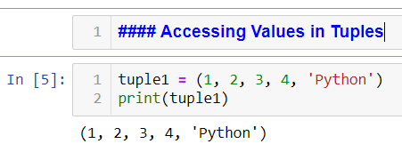
2. Tuples: Tuples are similar to lists which is used to store the collection of multiple data. Tuples are ordered and mutable or unchangeable. Tuple is represented as parentheses “ ( ) “. Ex: tuple = ( )
Tuples have two methods
1. index( ) : Returns the index position of particular value in tuple.
2. count( ) : Returns the count of items in the tuple.

Slide 23
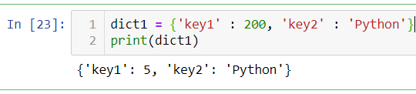
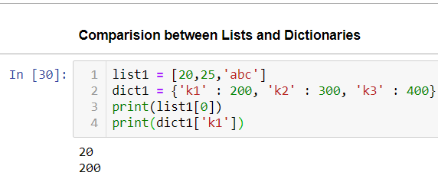
3.Dictionary: Dictionaries in Python are used to store the collection of data. Dictionaries are unordered and changeable. It is represented as flower brackets. Ex: dict = { }
Dictionaries have a pair of “keys” and “values” separated by “ : “.
“key1, key2” are act as keys in dict1 and “200, Python” are act as values in the dictionary “dict1”.
In lists, we can get a value using index of that particular value. Similarly, in dictionaries we can get any value using its key. Here Keys are act as an index of the Values.
Key is the unique identifier for a value Value is data that can be accessed with a key.

Slide 24
Dictionary Methods: dict1 = { ' k1 ' : 200, ' k2 ' : 300, ' k3 ' : 400 }
copy( ) - Returns the copy of dictionary Example: dict2 = dict1.copy( ) Result: dict2 = { ' k1 ' : 200, ' k2 ' : 300, ' k3 ' : 400 }
fromkeys( ) - Returns specified keys and values Example: x = (‘key1’ , ‘key2’) y = 0 newDict = dict.fromkeys(x, y) Result: newDict = [ ‘key1’ : 0, ‘key2’ = 0 ]
get( ) - Gets the value using particular key. Example: dict1.get( ‘ k1 ’ ) Result: 200
items( ) - Returns the list containing tuple for each pair of key and value Example: dict1.items( ) Result: dict_items ([('k1', 200), ('k2', 300), ('k3', 400)])
keys( ) - Similar to get( ) method. Example: dict1.keys( ) Result: dict_keys(['k1', 'k2', 'k3'])
values( ) - Returns the list containing tuple for each pair of key and value Example: dict1.items( ) Result: dict_items ([('k1', 200), ('k2', 300), ('k3', 400)])

Slide 25
Dictionary Methods: dict1 = { ' k1 ' : 200, ' k2 ' : 300, ' k3 ' : 400 }
pop( ) - Removes the value using specified key
Example: dict1.pop( ‘ k1 ‘ )
popitem( ) - Removes the key and value at the end of the dictionary
Example: dict1.popitem( ) Result: dict1 = { ' k1 ' : 200, ' k2 ' : 300 }
setdefault( ) - If key does not exist, this method insert key. Returns the value of particular key
update( ) - Updates the values of specified key
Example: dict1.update({'color' : 'green'}) Result: dict1 = {'k1': 200, 'k2': 300, 'k3': 400, 'color': 'green'}
clear( ) - Removes all items in the dictionary Example: dict1.clear( ) Result: { }

Slide 26
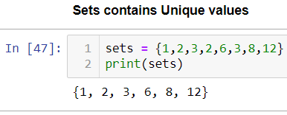
4.Sets: Sets are used to store the collection of data in python. It is unordered and unindexed. Sets contain unique values. It is also represented as curly brackets. Ex: Set = { } or Set( )
Methods in Sets:
add( ) : Adds an element at the end of the Set
copy( ) : Returns copy of the
Set clear( ): removes all the elements in the set
pop( ) : Removes the element from the end of the Set
remove( ) : Removes specified element
update( ) : Adds an entire set into another set.
difference( ) : Remove the common elements in two sets and Returns the unique elements in the first set.

Slide 27
difference_update( ): Returns the new updated set after make difference between the two sets.
intersection( ): Returns the set that is the intersection of two other sets.
intersection_update( ): Removes the elements in one set which is not there in another and Returns updated set.
discard( ): Removes specified element.
isdisjoint( ): Returns True, whether two sets are intersection.
issubset( ) : Returns True, whether two sets .
issuperset( ) : Similar to issubset. It will check all the elements in “values2” is present in “values1”, then it returns True.
symmetric_difference( ): Returns a set of elements that are present in either one set or another set
symmetric_difference_update ( ) : Returns newly updated set with symmetric difference between the two sets.
union( ) : Returns a set with elements present in both sets.

Slide 28
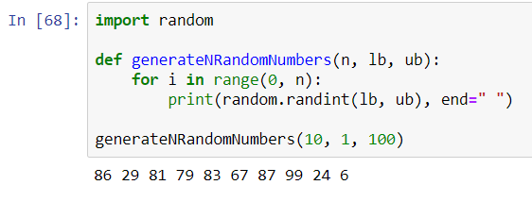
Packages and Modules
Module A single python file containing functions. A module is a software that has a specific functionality. It contains python statements and definitions to do a particular task. Modules are useful to break the large program into pieces. Some modules in Anaconda Navigator are math.sqrt, math.pi etc..
Packages Collection of Modules. Anaconda Navigator, in-build comes with a huge number of packages and libraries like numpy, sympy, math etc…
Example:
Task:
Add 3 contacts to your contacts application, which you created at the time of working on dictionaries

Slide 29
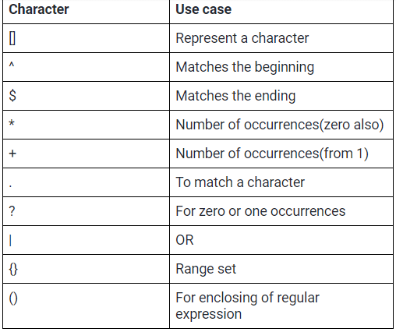
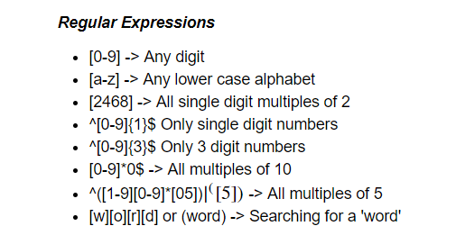
Regular Expressions
A Regular Expression (RegEx) is a sequence of characters that match a pattern. It is a symbolic representation. To use regular expressions, we have to import regular expressions(import re) while writing a program.

Slide 30
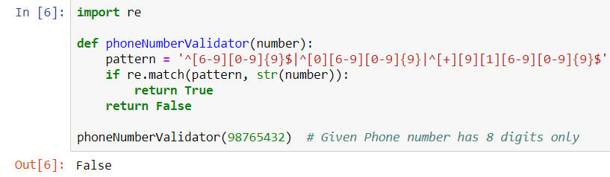
Examples on Regular Expressions:
Write a function to validate a phone number

Slide 31
Next Level of Topics
Maps
Lambda
Functional Programming
Iterators and Generators
Filters
Pandas
Numpy
Seaborn
Scipy

Slide 32


